Slide 1
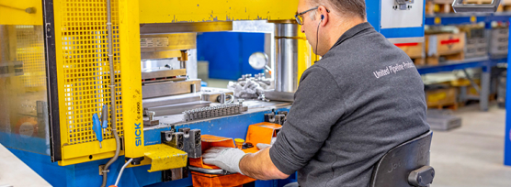
Toolbox
Machine safety: Press
Company name and date

Slide 2

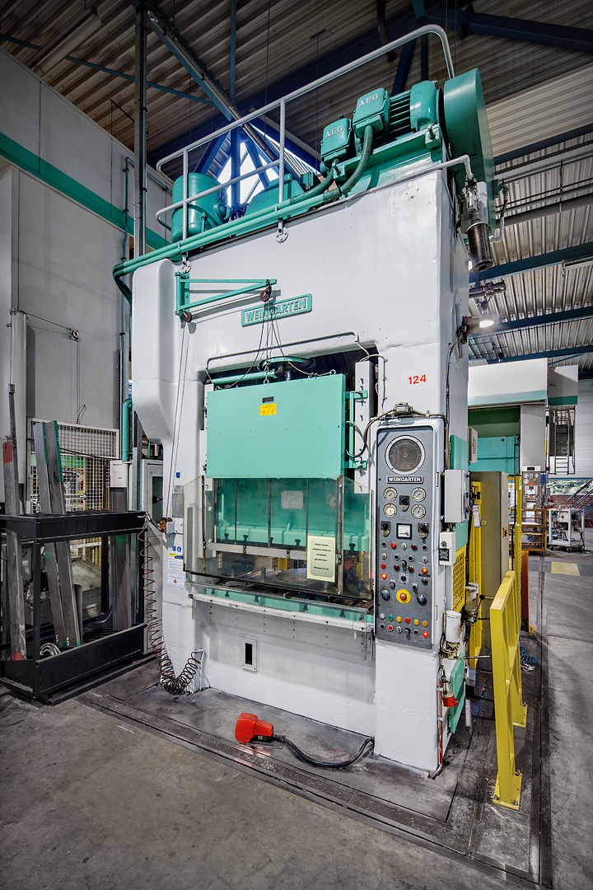
Contents
Safe and healthy working practices | Machine safety: Press
Why machine safety?
Top 3 accidents
Safe machine
What can you do yourself?

Slide 3
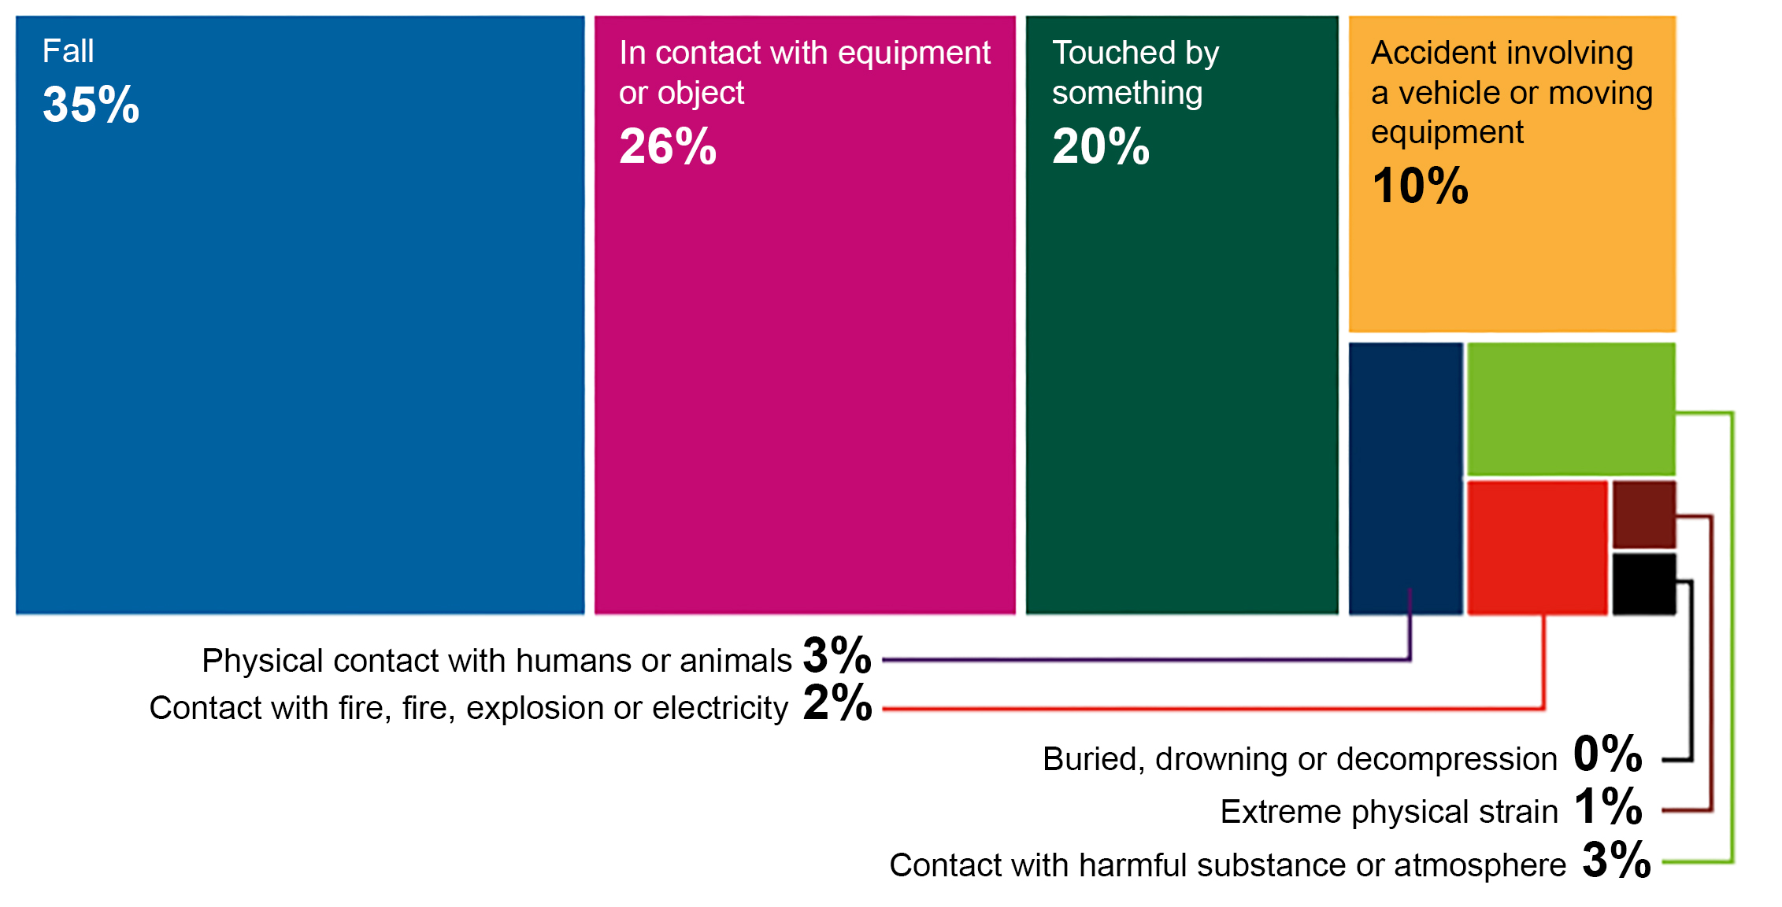
Safe and healthy working practices | Machine safety: Metal saw
Why machine safety?
Accident investigations completed in 2023, broken down by accident type.
Large proportion of the number of reported occupational accidents.
Contact with work equipment or object 26%.
Source: Work Accident Monitor 2023 – Dutch Labour Inspectorate
Notes:
https://www.nlarbeidsinspectie.nl/publicaties/rapporten/2024/08/26/monitor-arbeidsongevallen-2023
The accident type "Contact with work equipment or object" is common in the Industrial sector (42% of accidents in that sector). The majority of accidents involve accidents in which the victim came into contact with moving parts of a machine (69%).

Slide 4
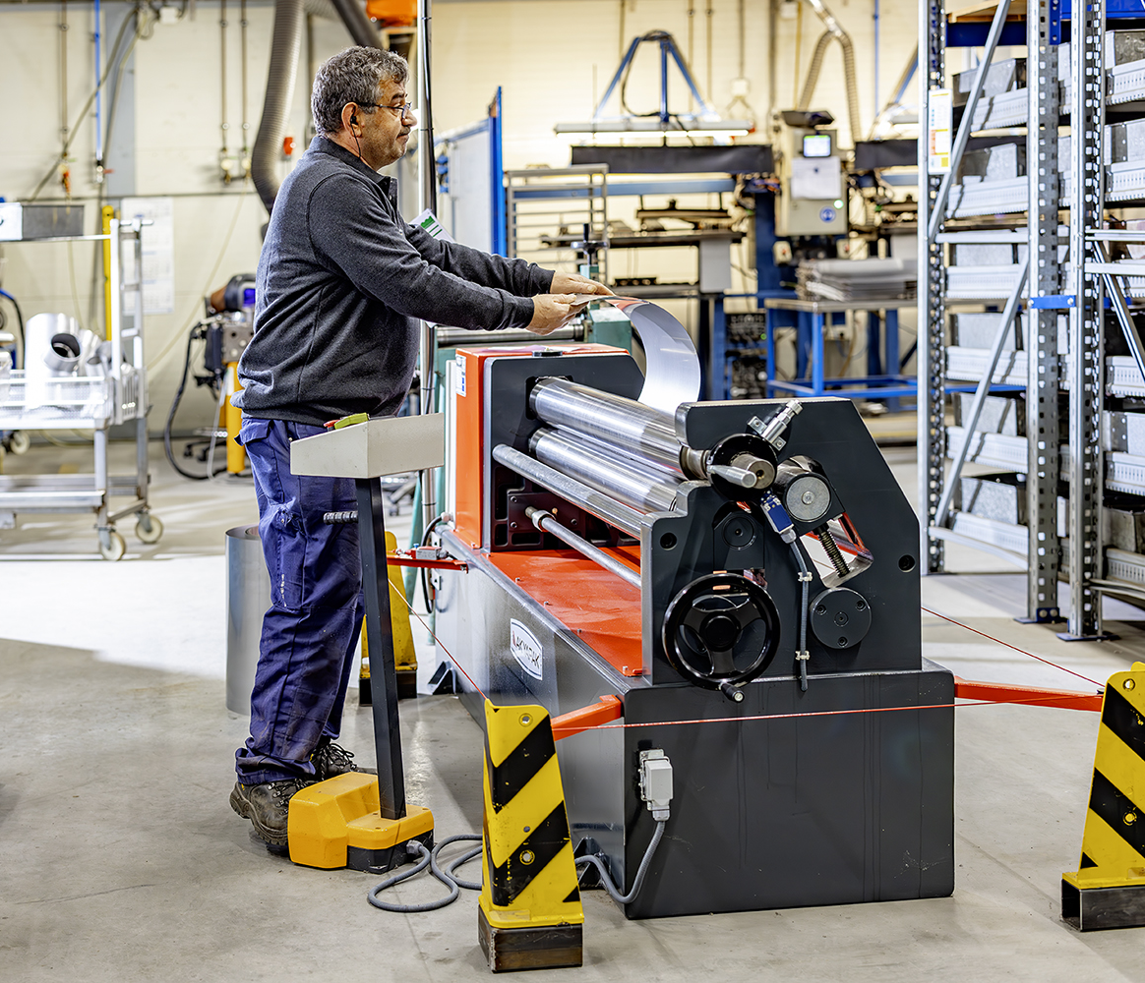
Guard missing
Safe and healthy working practices | Machine safety: Press
Why machine safety?
Cause of contact with moving parts:
Guard missing, but insufficiently effective
Guard removed
Incorrect operation

Slide 5
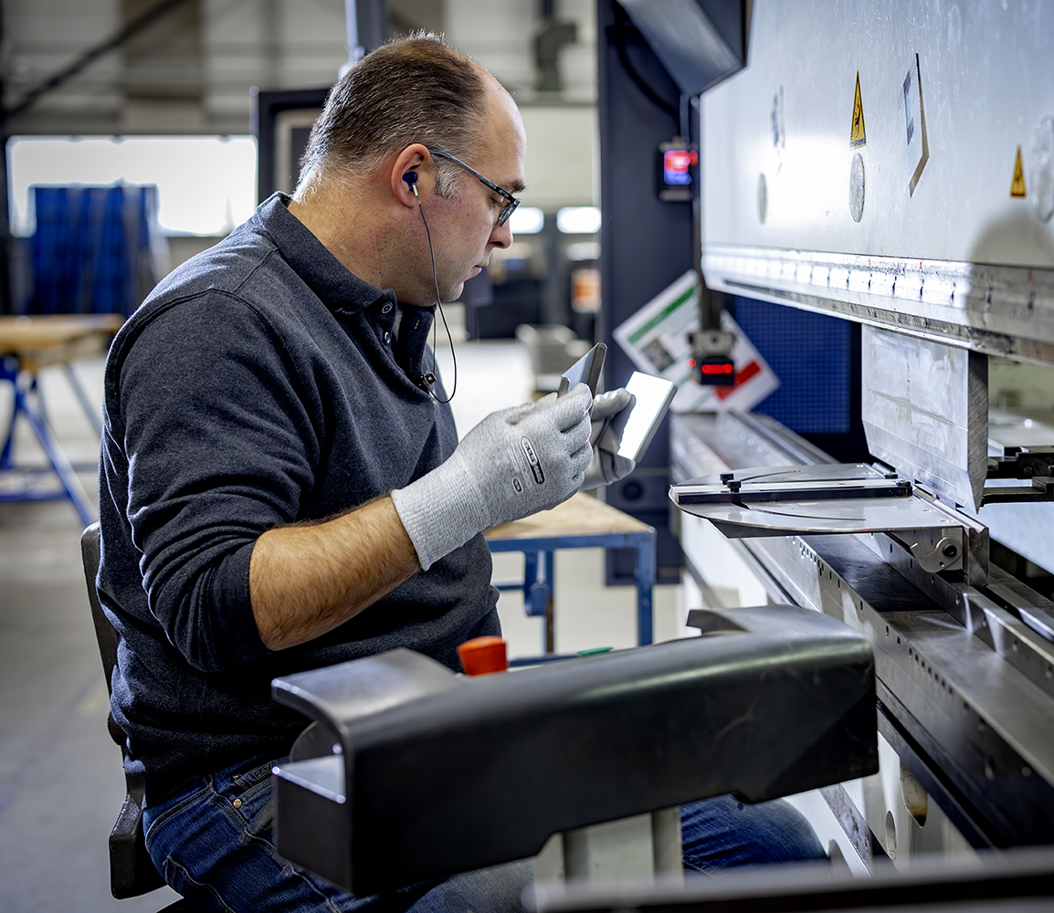
Reaching in.
Safe and healthy working practices | Machine safety: Press
Press accidents: top 3
Coming into contact with the press.
Failure to clamp the product securely.
Serious and permanent injury:
Amputation and fractures of fingers or fingertips resulting in loss of function.

Slide 6
Closed stamp without potential pinch hazard due to moving press.
Safe and healthy working practices | Machine safety: Press
Safe machine
Half-closed stamp/letterbox opening (opening including workpiece smaller than 6 mm).
Coupling guard with moving front guard and fixed sides.
Fixed guard and automatic material feed and discharge.
Light curtain safety device (only permitted on presses with friction clutch).
Two-hand control (only permitted on presses with friction clutch).
Flywheel guard.

Slide 7
Check that the plugs, cables and connections are undamaged.
Safe and healthy working practices | Machine safety: Press
Safe machine
Check that the drive is undamaged.
Check that the emergency stop is readily accessible during use.
Check that the flywheel is shielded.

Slide 8
Ensure a clean and tidy working environment.
Safe and healthy working practices | Machine safety: Press
Safe operation
Check the brake function every day.
Test the emergency stop button.
Never bypass safety devices.
If safety devices are missing or have been bypassed, discuss this with your manager.
Do not start work if you have any doubts about the safety of the machine; discuss this with your manager.

Slide 9

Safe and healthy working practices | Machine safety: Press
Questions?
info@5xbeter.nl | www.5xbeter.nl

Slide 10
Safe and healthy working practices | Machine safety: Press
Need help?
Discuss it with your manager or contact the health and safety officer.
Consult an Improvement Coach from 5xbeter: www.5xbeter.nl
Or call the FREE Improvement Line: 0800 – 55 55 005
info@5xbeter.nl | www.5xbeter.nl

